Slide 1
SECURING CLOUD HYPERVISORS
Ch.Sai Gireesh(211417104044) Guide By :
Ch.Sushwanth(211417104043) M.Mohan
G.Manohar Krishna(211417104073)

Slide 2
ABSTRACT
Cloud Computing is increasingly becoming popular as many enterprise applications and data are moving into cloud platforms. However, a major barrier for cloud adoption is real and perceived lack of security.
In order to better define these threats to which a cloud hypervisor is exposed, we conducted an in-depth analysis and highlighted the security concerns of the cloud. We basically focused on the two particular issues, i.e., (a) data breaches and (b) weak authentication.
For in-depth analysis, we have successfully demonstrated a fully functional private cloud infrastructure running on Cloud Stack for the software management and orchestrated a valid hack.
We analysed the popular open-source hypervisors, followed by an extensive study of the vulnerability reports associated with them. Based on our findings, we propose the characterization and countermeasures of hypervisor’s vulnerabilities.

Slide 3
LITERATURE SURVEY
Over the past few years, demand for access to data for ever-increasing online users has grown exponentially, with the traditional data centre model not being able to cope with the access from anywhere and any device.
This changing world has forced the need to create a new way of supporting these demands; the cloud. This environment creates a model enabling ubiquitous, ondemand services with the advantages of rapid deployment and revenue savings .
Small businesses are embracing cloud technology because it allows them to use enterprise infrastructure only previously afforded by larger companies .
Although there is no universal definition of cloud computing , most authors seem to have adopted the National Institute of Standards and Technology (NIST) definition of three service models (service, platform, and infrastructure) and four deployment models (private, community, public, and hybrid) .

Slide 4
PROBLEM STATEMENT
In the past, hackers used multiple computers or a botnet to produce a great amount of computing power in order to conduct cyber-attacks on computer systems. This process is complicated and can take months to complete.
Nowadays, a powerful computing infrastructure, including both software and hardware components, could be easily created using a simple registration process in a cloud computing service provider. By taking advantage of the prevailing computing power of cloud networks, hackers can fire attacks in a very short time.

Slide 5
TECHNOLOGY STACK
Windows or any Unix Host
VMWare Workstation Pro
Ubuntu
LAMP Stack Web Application
Kali Linux
NMAP
Metasploit
Wireshark

Slide 6
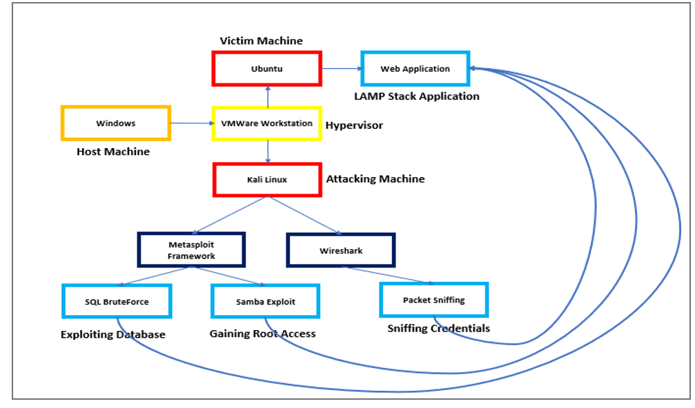
SYSTEM ARCHITECTURE

Slide 7
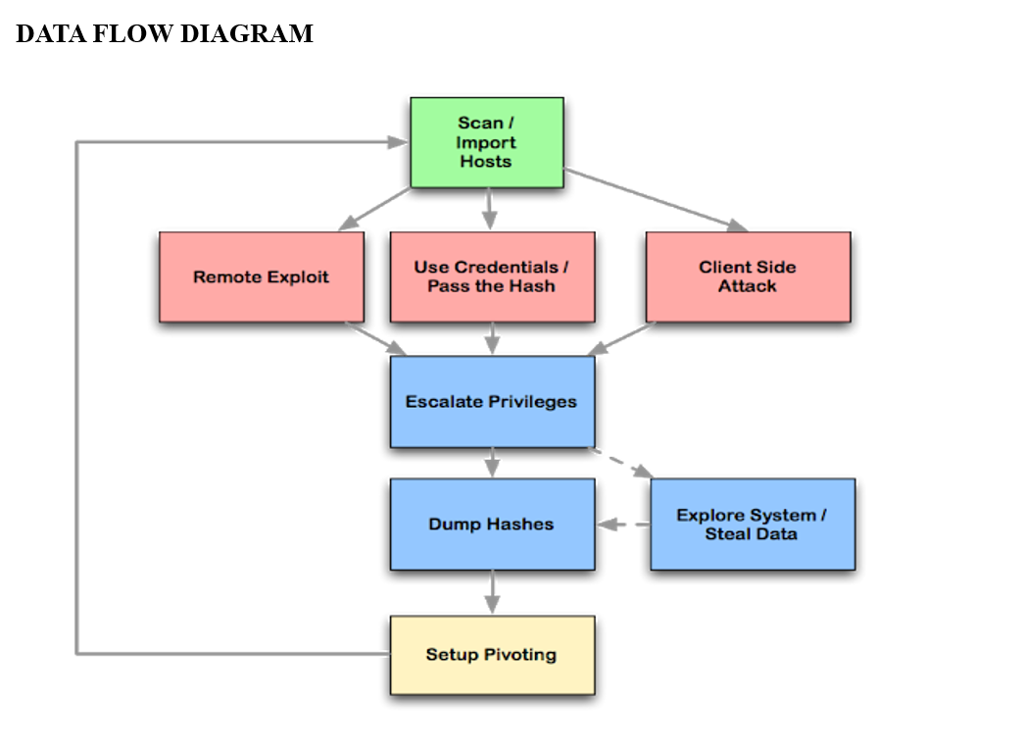
SYSTEM DESIGN

Slide 8
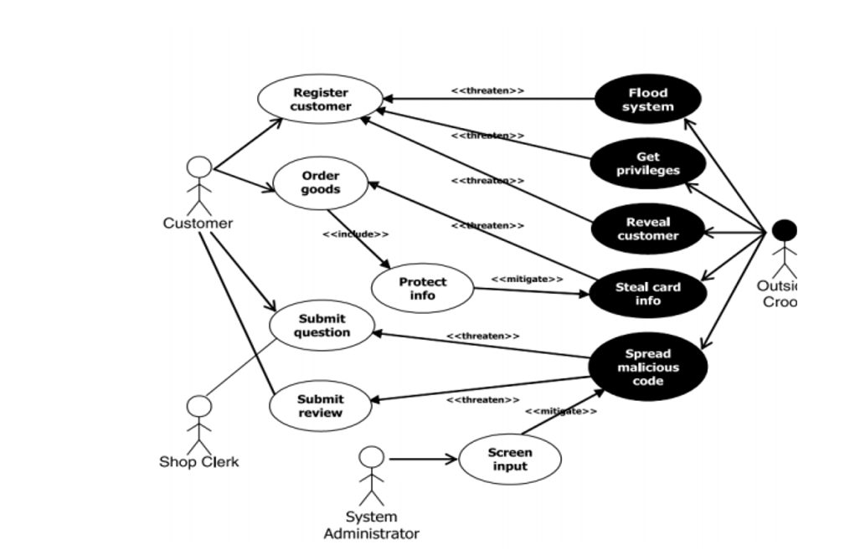
UML DIAGRAM

Slide 9
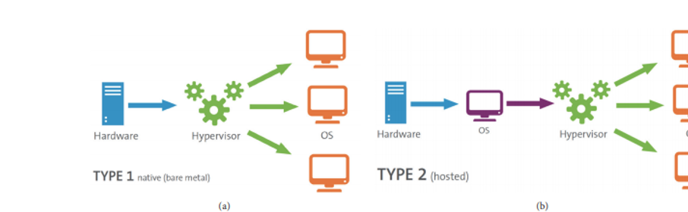
HYPERVISOR FLOW DIAGRAM

Slide 10
MODULE DESIGN SPECIFICATION
Most people assume that all a penetration tester, or hacker, needs to do is sit down in front of a computer and begin typing an obscure string of code and voila any computer in the world is instantly opened.
This stereotype based in Hollywood legend is far from the truth. Professionals in this field are very meticulous in the approach used when to uncovering and exploiting vulnerabilities in computer systems.
Over time a proven framework has emerged that is used by professional ethical hackers. The four phases of this framework guide the penetration tester through the process of empirically exploiting information systems in a way that results in a well-documented report that can be used if needed to repeat portions of the testing engagement.
This process not only provides a structure for the tester but also is used to develop high-level plans for penetration testing activities.

Slide 11
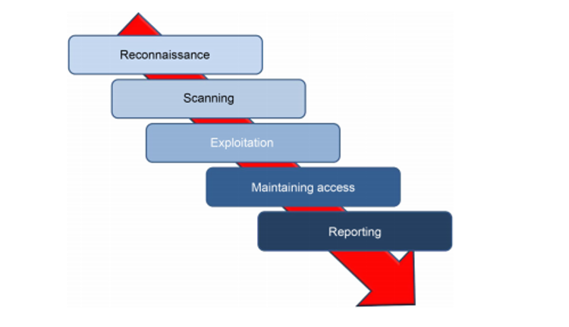

Slide 12
RECONNAISSANCE
This phase starts with the test team knowing little about the target. The level of detail provided to the team can range from knowing only the organizations name and possibly a website address to detailed and specific system information including IP address space and technologies used defined in the ROE to limit or scope the test event.
The ROE may also limit the test team’s ability to conduct activities including bans on social engineering and destructive activities like denial of service (DoS) and distributed denial of service (DDoS) attacks. The targets own website holds vast information for developing the profile for the engagement.
For example, many sites proudly display organizational charts and key leader’s profiles. These should be used as a basis for developing a target profile and information about key leaders in the organization can be used for further harvesting of information on social media sites and for social engineering, if allowed in the stated ROE.

Slide 13
SCANNING
After the penetration tester has completed the reconnaissance phase of an organization, they will move into the scanning phase. In this phase, the penetration tester can take the information learned about the employees, contractors, and information systems to begin expanding the view of physical and logical information system structures within the organization.
Like any of the other phases in the penetration testing lifecycle, the penetration tester can return to earlier phases as needed to gain more information to enhance information gathered in the scanning phase.
The main focus of the scanning phase is to determine specific information about the computers and other devices that are connected to the targeted network of the organization. Throughout this phase, the focus is on finding live hosts, determining node type (desktop, laptop, server, network device, or mobile computing platform), operating system, public services offered (web applications, SMTP, FTP, etc.), and even possible vulnerabilities.
Vulnerabilities at this level are often referred to as, “low hanging fruit.” Scanning is done with a number of different tools; however, this chapter will focus on some of the best known and most effective tools including Nmap, Hping, and Nessus. The goal of this phase is to have a listing of possible targets for the next phase of the penetration testing lifecycle: exploitation.

Slide 14
EXPLOITATION
As defined by the National Institute of Science and Technology (NIST), Special Publication 80030, Appendix, B, page B-13, a vulnerability is a “weakness in an information system, system security procedures, internal controls, or implementation that could be exploited by a threat source;” however, this definition is too broadly scoped for use when discussing exploitation and requires further explanation. A vulnerability is caused by an “error.”
The error can exist in multiple places throughout the information system AND through the humans that either use or administer the networks and computers on a daily basis. Vulnerabilities with the information system can exist inside or outside of the network, lay dormant in poorly coded and unchecked software, generated through improper security controls (more pecifically, through haphazardly configured applications and network devices), or outside of the technical network through various social means that exploit the users of the information system.
Consider for a moment that the word vulnerability is synonymous with the word weakness. Exploitation is simply using a weakness to leverage access into an information system or render is useless via a denial of service. The only limit of the exploitation from an attacker is the breakdown of pure drive and willpower to continue fighting against the security measures in place protecting the information system.
The best tool a penetration tester has is his or her brain. Remember that there are many doors, or points of entry, into a system. If you find that one door is closed, move on to the next. Exploitation is one of the hardest and most coveted talents of a penetration tester. It takes time, knowledge, and great persistence to learn all of the attack types for a single attack vector.

Slide 15
MAINTAINING ACCESS
Exploiting a computer, networking device, or web service is great; however, the goal of most penetration tests is to maintain access to the compromised system. There are a number of methodologies for maintaining access to exploited victim systems; however, the overarching conclusion of every methodology is not to steal information but to reduce the time-consuming and exhaustive efforts required to keep attacking the same machine over and over after it’s already been compromised.
If a security tester is working with a team, remote collocated servers or is in need of a secondary access point for a later access to the computer system, then efforts and expectation can be easily managed and further attacks can be more precise. Maintaining access is a secondary art form that involves just as much, if not more, thought than the exploitation of a system.
This chapter covers the basic concepts of security testers and hackers alike use to maintain access and keep the compromised session going. Some of the concepts presented are very advanced. The reader should not get discouraged if reading this chapter doesn’t make sense the first time though. This chapter ends with a section designed to keep the reader’s attention focused and help reenforce the advanced methodologies presented.

Slide 16
SYSTEM TESTING
Black Box Penetration Testing: In this approach, the tester assesses the target system, network or process without the knowledge of its details. They just have a very high level of inputs like URL or company name using which they penetrate the target environment. No code is being examined in this method.
White Box Penetration Testing: In this approach, the tester is equipped with complete details about the target environment – Systems, network, OS, IP address, source code, schema, etc. It examines the code and finds out design & development errors. It is a simulation of an internal security attack.
Grey Box Penetration Testing: In this approach, the tester has limited details about the target environment. It is a simulation of external security attacks.

Slide 17
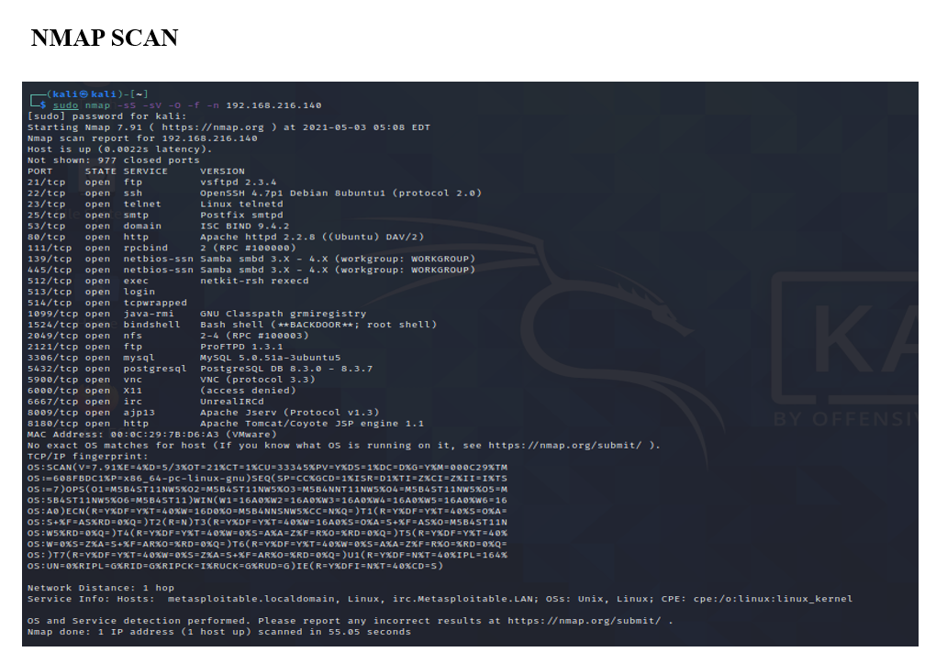

Slide 18
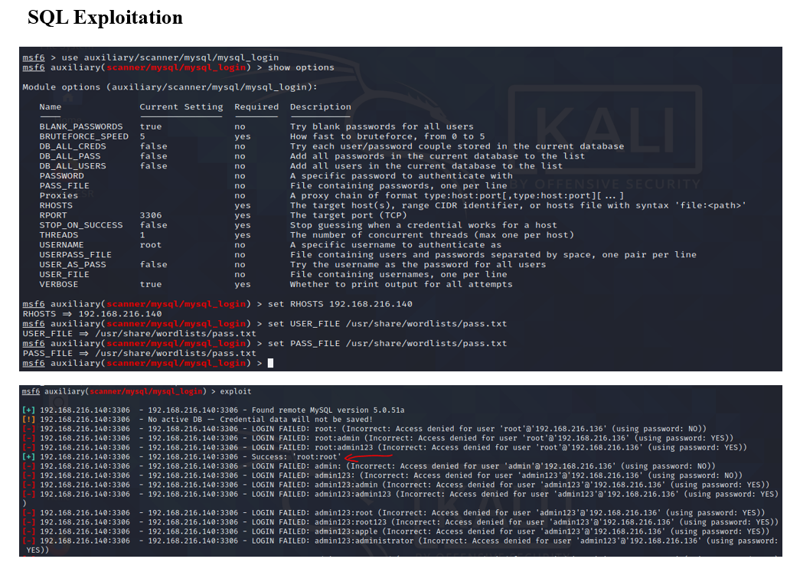

Slide 19
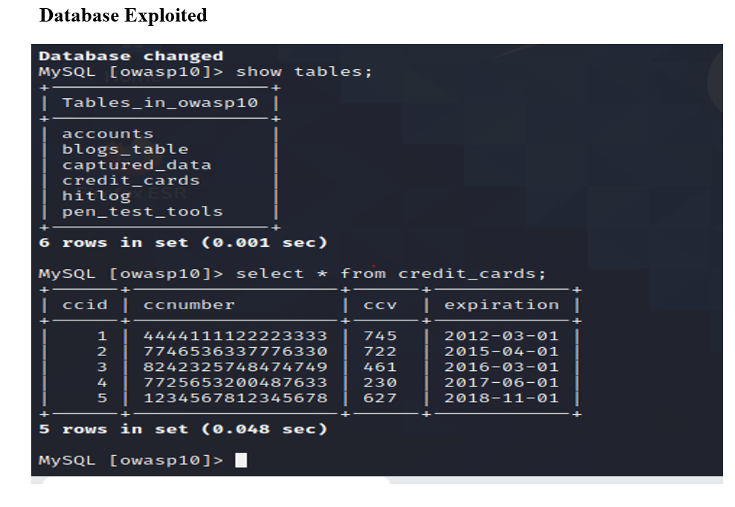

Slide 20
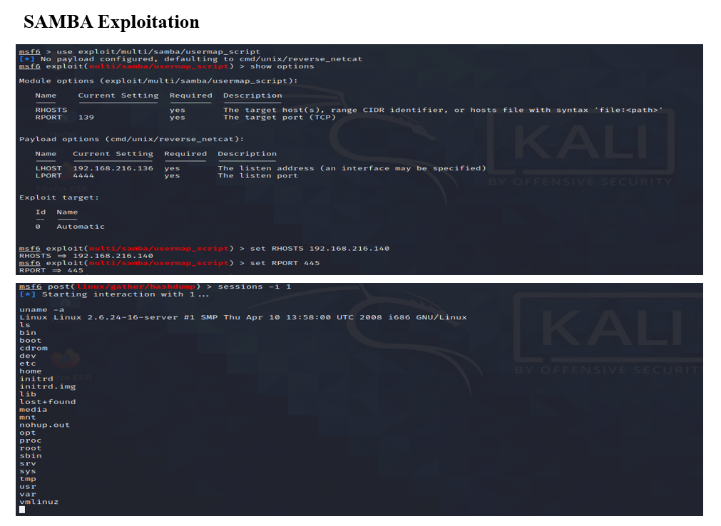

Slide 21
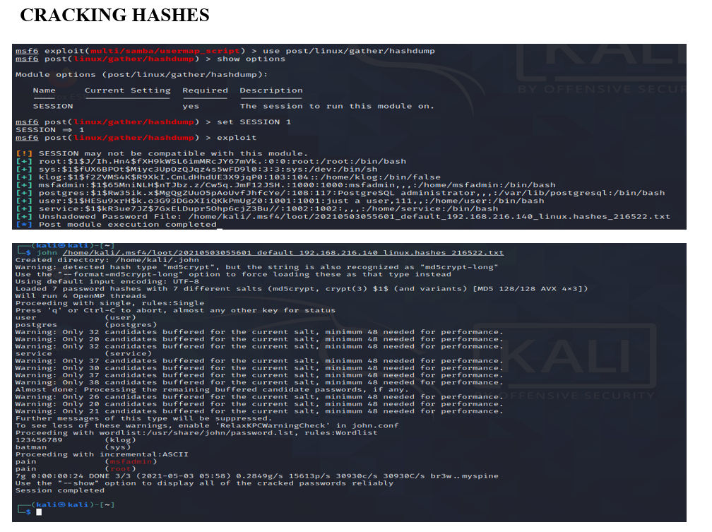

Slide 22
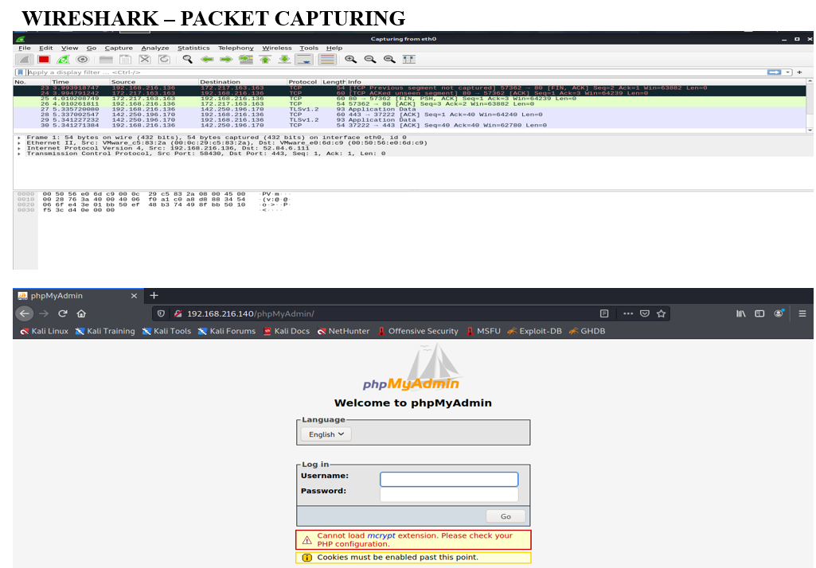

Slide 23
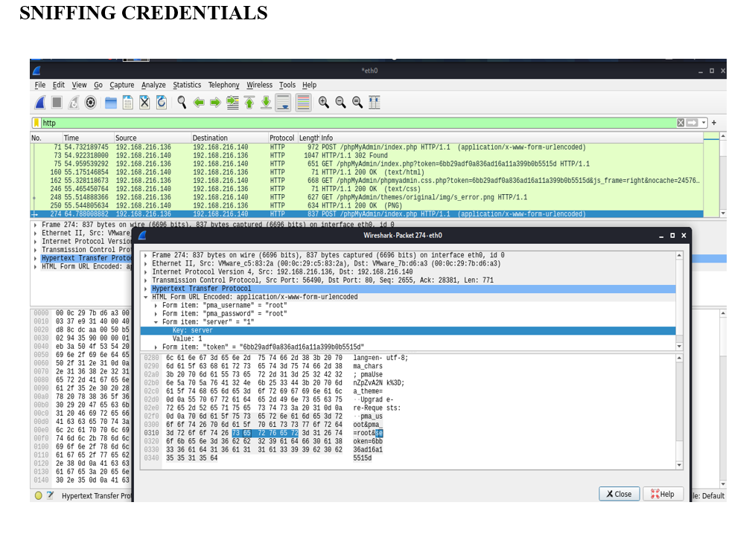

Slide 24
CONCLUSION
Cloud computing is in continual development in order to make different levels of on-demand services available to customers. While people enjoy benefits cloud computing brings, security in clouds is a key challenge.
Much vulnerability in clouds still exists and hackers continue to exploit these security holes. In order to provide better quality of service to cloud users, security flaws must be identified.
In this paper, we examined the security vulnerabilities in clouds from three perspectives (abuse use of cloud computational resources, data breaches, and cloud security attacks), included related real-world exploits, and introduced countermeasures to those security breaches.
In the future, we will continue to contribute to the efforts in studying cloud security risks and the countermeasures to cloud security breaches.

Slide 25
REFERENCES
[1] S. Singh, Y. Jeong, and J. H. Park, “A survey on cloud computing security: Issues, threats, and solutions,” Journal of Network and Computer Applications, vol. 75, pp. 200–222, 2016.
[2] NIST, Final Version of NIST Cloud Computing Defnition Published, 2011.
[3] L. Turnbull and J. Shropshire, “Breakpoints: An analysis of potential hypervisor attack vectors,” in Proceedings of the IEEE SoutheastCon 2013: Moving America into the Future, 2013.
[4] S. Manavi and S. Mohammadalian, “Secure model for virtualization layer in cloud infrastructure,” International Journal of Cybersecurity and Digital Forensics, vol. 1, no. 1, pp. 32–40, 2012.
[5] L. Almutair and H. Zaghloul, in Proceedings of the Te Tird International Conference on Digital Information Processing and Communications (ICDIPC ’13), pp. 676–686, UAE, 2013.

Slide 26
THANK YOU

